Slide 1
Computer Vision
Part 2: Visualization via Optimization
ADF

Slide 2

Agenda
Part 1: Visualizing Weights
Feature Representation, Image Patch Activation
Part 2: Visualization via Optimization
Input that maximizes the target
Deep Dream
Computer Vision

Slide 3
Next Question
We’ve flipped our perspective
If, during training, we optimize weights from fixed input to maximize the target,
Can we optimize input, from fixed trained weights, to also maximize the target?
Computer Vision

Slide 4
Optimizing Class Image
Computer Vision

Slide 5
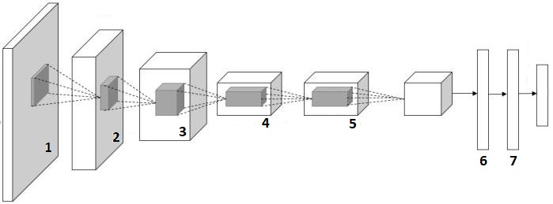
Optimization to Image: Gradient Ascent
Optimize an image that maximized some class score
Computer Vision

Slide 6
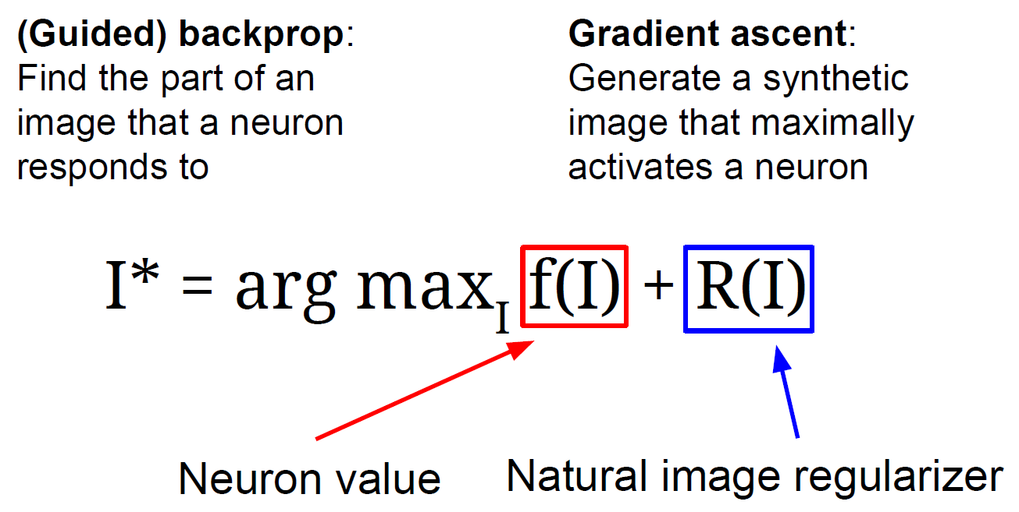
Gradient Ascent
Computer Vision

Slide 7
Optimization to Image
Generate zero or random image
Forward pass to the last layer before Softmax activation
Zero Image
Computer Vision

Slide 8
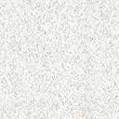
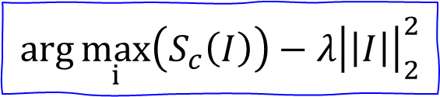
Optimization to Image
Set gradient=1.0 for the target class, and 0 for the other
Backprop to image, Do a small “image update”
Repeat until converge
$$\arg{\max_{i}\left(S_{c}\left(I\right)\right)−λ{\left|\left|I\right|\right|}_{2}^{2}}$$
Zero Image
0
1
0
…
0
gradient input
Computer Vision

Slide 9
Computer Vision

Slide 10
Computer Vision

Slide 11
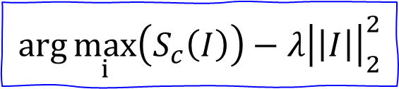
Possible for any arbitrary neurons
Generate zero or random image
Forward pass to any selected layer
Set gradient activation=1, backprop
$$\arg{\max_{i}\left(S_{c}\left(I\right)\right)−λ{\left|\left|I\right|\right|}_{2}^{2}}$$
Zero Image
gradient input
Computer Vision

Slide 12
Deep Visualization
Computer Vision

Slide 13
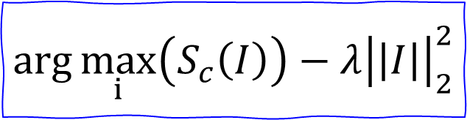
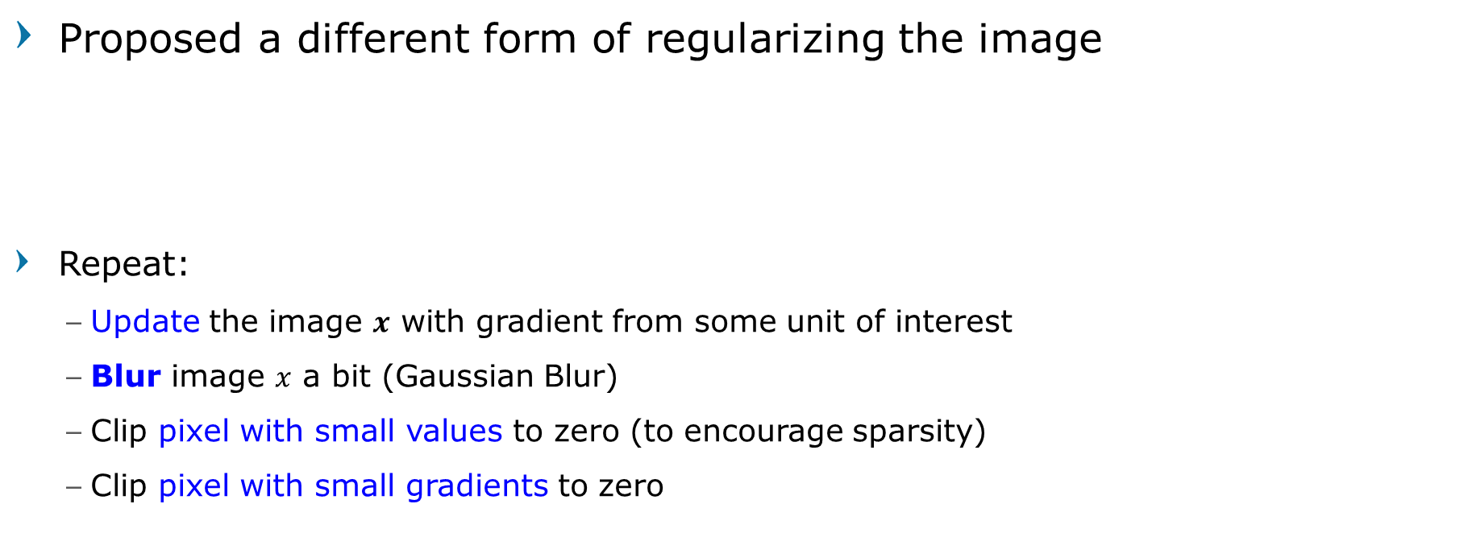
Deep Visualization
Proposed a different form of regularizing the image
Repeat:
Update the image $x$ with gradient from some unit of interest
Blur image $x$ a bit (Gaussian Blur)
Clip pixel with small values to zero (to encourage sparsity)
Clip pixel with small gradients to zero
$$\arg{\max_{i}\left(S_{c}\left(I\right)\right)−λ{\left|\left|I\right|\right|}_{2}^{2}}$$
Propose different regularizing
More Explicit scheme
[Understanding Neural Networks Through Deep Visualization, Yosinski et al. , 2015]
Computer Vision

Slide 14
Deep Visualization
Computer Vision

Slide 15
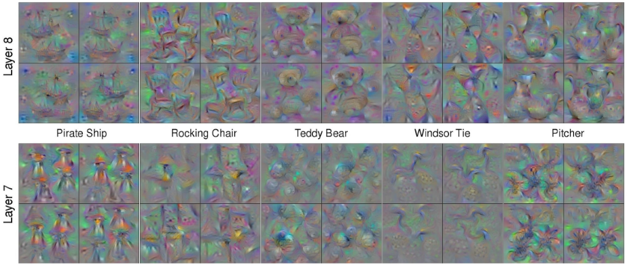
Deep Visualization
http://yosinski.com/deepvis
[Understanding Neural Networks Through Deep Visualization, Yosinski et al. , 2015]
Use the same approach to visualize intermediate features
Computer Vision

Slide 16
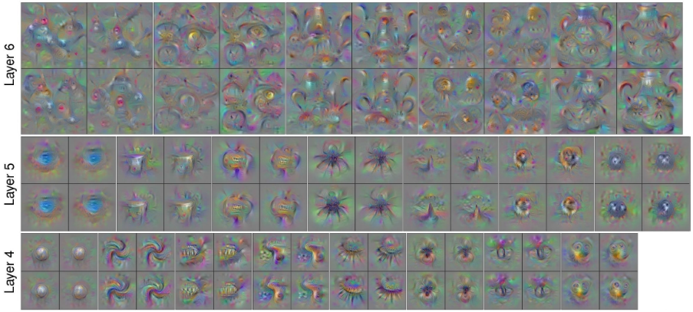
Deep Visualization
http://yosinski.com/deepvis
[Understanding Neural Networks Through Deep Visualization, Yosinski et al. , 2015]
Computer Vision

Slide 17
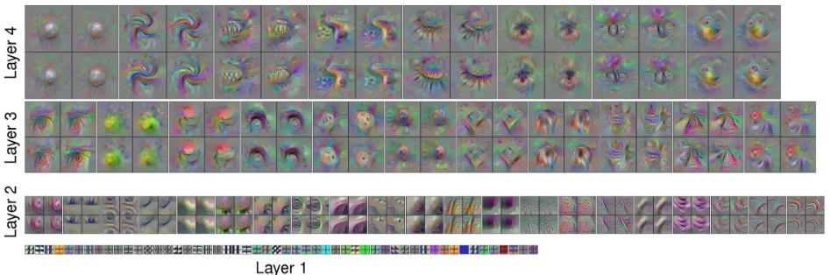
Deep Visualization
[Understanding Neural Networks Through Deep Visualization, Yosinski et al. , 2015]
http://yosinski.com/deepvis
Computer Vision

Slide 18
Conclusion 7 ?
Intuition: If an image with a cat in it produce high score for “cat class”
Then an image full of cat on top of each other will produce even higher “cat class score”
Computer Vision

Slide 19
Deep Dream (Introduction)
Computer Vision

Slide 20
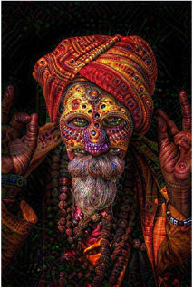
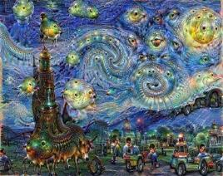
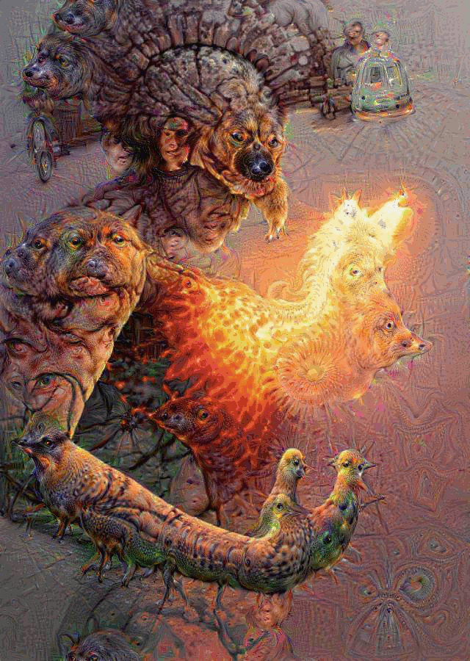
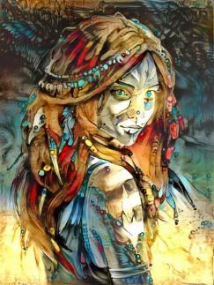
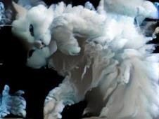
DeepDream https://github.com/google/deepdream
Computer Vision

Slide 21
Deep Dream: Amplify existing features
Rather than synthesizing an image to maximize a specific neuron,
Instead try to amplify the neuron activations at some layer in the network
Computer Vision

Slide 22

Deep Dream: Amplify existing features
gradient input
Choose an image and a layer in a CNN; repeat:
1. Forward: compute activations at chosen layer
2. Set gradient of chosen layer equal to its activation
3. Backward: Compute gradient on image
4. Update image
Computer Vision

Slide 23
Computer Vision
Notes:
Amplified the features that maximally activated in the network

Slide 24
Computer Vision
Notes:
Amplified the features that maximally activated in the network

Slide 25
Deep Dream: Amplify existing features
DeepDream modifies the image in a way that “boosts” all activations, at any layer
this creates a feedback loop: e.g. any slightly detected dog face will be made more and more dog like over time
Computer Vision

Slide 26
Computer Vision
Notes:
Amplified the features that maximally activated in the network

Slide 27
Computer Vision

Slide 28
Computer Vision

Slide 29
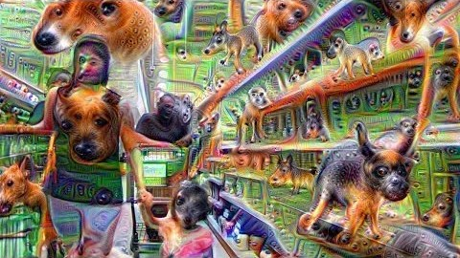
Pouff - Grocery Trip
Computer Vision

Slide 30
Computer Vision
Notes:
MIT Places Dataset: 205 categories, 2.5 million images

Slide 31
More Next Week
Computer Vision

Slide 32
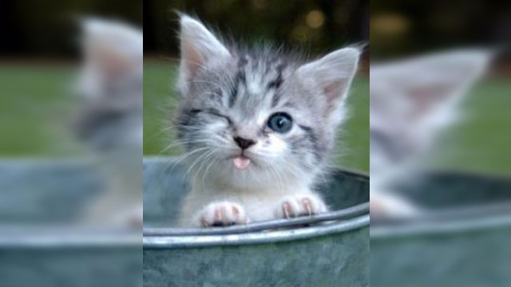
Fooling ConvNets
Computer Vision

Slide 33
Fooling ConvNets
ConvNet is said to be really powerful
We can pose an optimization over the input image to maximize any class score.
Question: Can we use this to “fool” ConvNets?
Answer: oh yeah!
Computer Vision

Slide 34
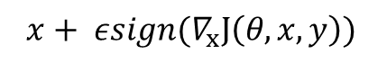
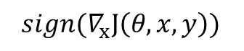
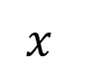
Fooling ConvNets
+ 0.007*
=
$$x$$
$$sign(∇_{x}J\left(θ,x,y\right))$$
$$x+ εsign(∇_{x}J\left(θ,x,y\right))$$
57.7% “panda”
8.2% “nematode”
99.3% “gibbon”
Computer Vision

Slide 35
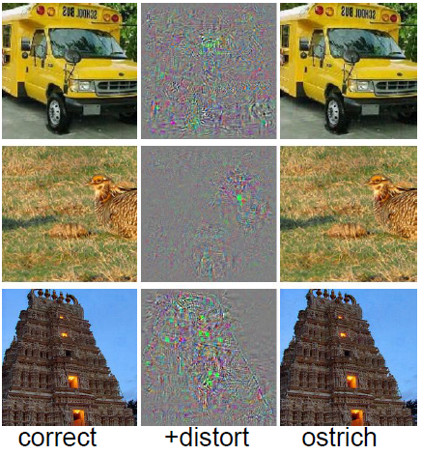
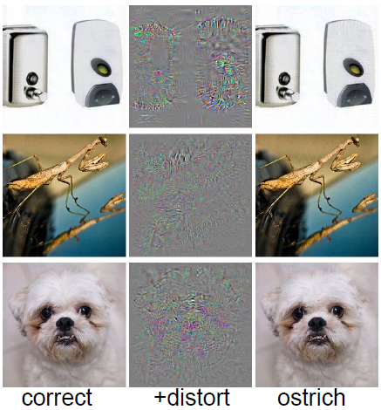
Computer Vision
[Intriguing properties of neural networks, Szegedy et al., 2013]

Slide 36
Adversarial Examples
EXPLAINING AND HARNESSING ADVERSARIAL EXAMPLES
[Goodfellow, Shlens & Szegedy, 2014]
Computer Vision

Slide 37
Adversarial Examples
Inputs formed by applying small but intentionally worst-case perturbations to examples from the dataset
Deep networks are vulnerable to adversarial examples - Misguided assumption
Convolutional Neural Network

Slide 38
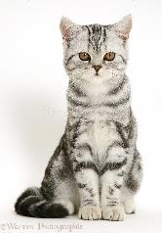
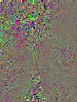

Generating Adversarial Example
Feed an Image
Class score
0
1
…
…
0
Choose wrong class set gradient=0 except the chosen class
Backprop Gradients
Add to Image
Computer Vision
Notes:
- Pick on a arbitrary neuron, say in pool5 layer, pipe a lot of images through, and see what excites the neurons the most
- example: row → neuron, image→ something that excites neuron

Slide 39
Adversarial Examples
Computer Vision
Notes:
Linear nature of the functions in forward pass

Slide 40
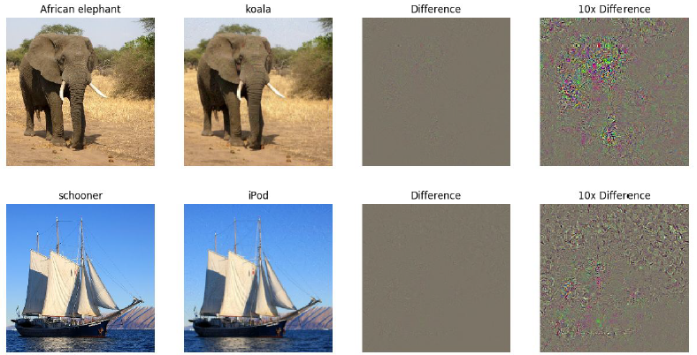
[Intriguing properties of neural networks, Szegedy et al., 2013]
Computer Vision

Slide 41
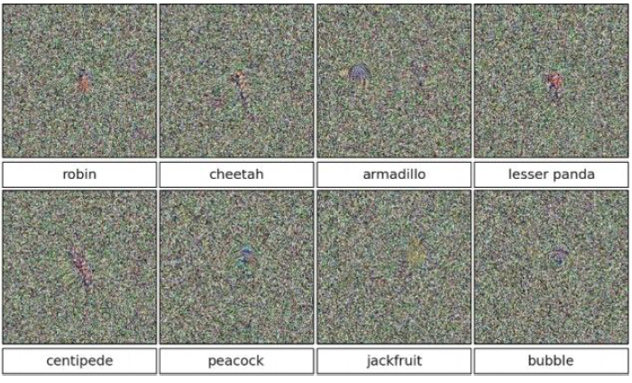
>99.6%
confidences
[Deep Neural Networks are Easily Fooled: High Confidence Predictions for Unrecognizable Images Nguyen, Yosinski, Clune, 2014]
Computer Vision

Slide 42
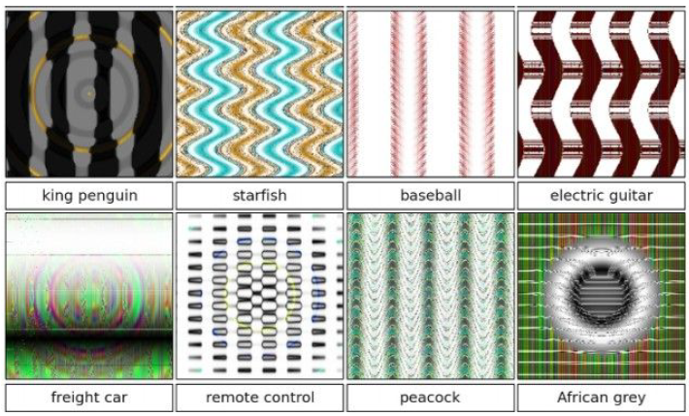
>99.6%
confidences
[Deep Neural Networks are Easily Fooled: High Confidence Predictions for Unrecognizable Images Nguyen, Yosinski, Clune, 2014]
Computer Vision

Slide 43
Adversarial Examples
Machine learning models misclassify examples that are only slightly different from correctly classified examples drawn from the data distribution
In particular, this is not a problem with Deep Learning, and has little to do with ConvNets specifically.
Same issue would come up with Neural Nets in any other modalities
Convolutional Neural Network

Slide 44
Not just for neural nets
Linear models
Logistic regression
Softmax regression
SVMs
Decision trees
Nearest neighbors
Convolutional Neural Network

Slide 45
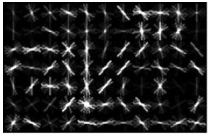
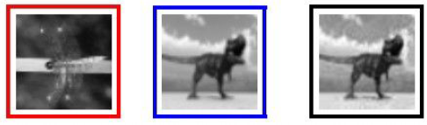
Old cases
These kinds of results were around even before ConvNets
Identical HOG representation
[Exploring the Representation Capabilities of the HOG Descriptor, Tatu et al., 2011]
Convolutional Neural Network

Slide 46
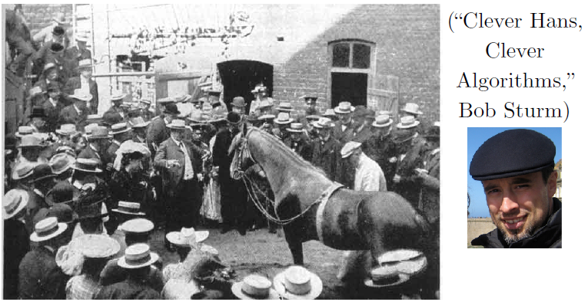
Clever Hans
Computer Vision

Slide 47
Adversarial Examples
“primary cause of neural networks’ vulnerability to adversarial perturbation is their linear nature“
EXPLAINING AND HARNESSING ADVERSARIAL EXAMPLES[Goodfellow, Shlens & Szegedy, 2014]
adversarial examples expose fundamental blind spots in training algorithms
Convolutional Neural Network
Notes:
Linear nature of the functions in forward pass

Slide 48
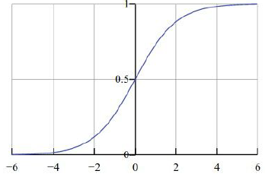
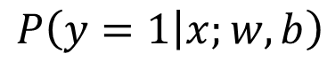
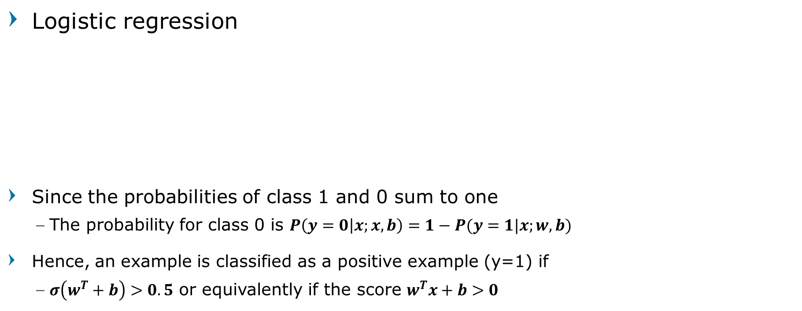
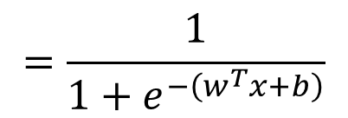
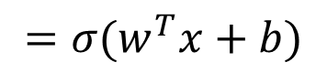
Fooling binary linear classifier
Logistic regression
Since the probabilities of class 1 and 0 sum to one
The probability for class 0 is $P\left(y=0 | x;x,b\right)=1−P(y=1|x;w,b)$
Hence, an example is classified as a positive example (y=1) if
$σ\left(w^{T}+b\right)>0.5$ or equivalently if the score $w^{T}x+b>0$
$$=\frac{1}{1+e^{−\left(w^{T}x+b\right)}}$$
$P\left(y=1 | x;w,b\right)$
$$=σ(w^{T}x+b)$$
Computer Vision

Slide 49
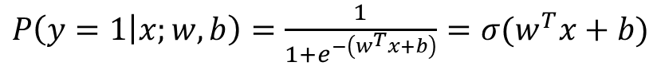
Fooling binary linear classifier
x | 2 | -1 | 3 | -2 | 2 | 2 | 1 | -4 | 5 | 1
w | -1 | -1 | 1 | -1 | 1 | -1 | 1 | 1 | -1 | 1
input example x
weights
? | ? | ? | ? | ? | ? | ? | ? | ? | ?
adversarial x
class 1 score = dot product:
= -2 + 1 + 3 + 2 + 2 - 2 + 1 - 4 - 5 + 1
= -3
➔ probability of class 1 is 1/(1+e⁻⁽⁻³⁾)= 0.0474
i.e. the classifier is 95% certain that this is class 0 example
$P\left(y=1 | x;w,b\right)=\frac{1}{1+e^{−\left(w^{T}x+b\right)}}=σ(w^{T}x+b)$
Computer Vision

Slide 50
Fooling binary linear classifier
x | 2 | -1 | 3 | -2 | 2 | 2 | 1 | -4 | 5 | 1
w | -1 | -1 | 1 | -1 | 1 | -1 | 1 | 1 | -1 | 1
input example x
weights
1.5 | -1.5 | 3.5 | -2.5 | 2.5 | 1.5 | 1.5 | -3.5 | 4.5 | 1.5
adversarial x
class 1 score before:
= -2 + 1 + 3 + 2 + 2 - 2 + 1 - 4 - 5 + 1
= -3
➔ probability of class 1 is 1/(1+e⁻⁽⁻³⁾)= 0.0474
i.e. we improved the class 1 probability from 5% to 88%
class 1 score now:
= -1.5+1.5+3.5+2.5+2.5-1.5+1.5-3.5-4.5+1.5
= 2
➔ probability of class 1 is now 1/(1+e⁻⁽⁻²⁾)= 0.88
Computer Vision

Slide 51
Fooling binary linear classifier
x | 2 | -1 | 3 | -2 | 2 | 2 | 1 | -4 | 5 | 1
w | -1 | -1 | 1 | -1 | 1 | -1 | 1 | 1 | -1 | 1
input example x
weights
1.5 | -1.5 | 3.5 | -2.5 | 2.5 | 1.5 | 1.5 | -3.5 | 4.5 | 1.5
adversarial x
This was only with 10 input dimensions.
Imagine a 224x224 input image that has 150,528.
(It’s significantly easier with more numbers, need smaller nudge for each)
Computer Vision

Slide 52
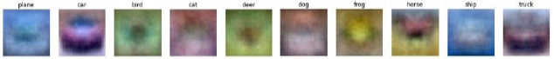
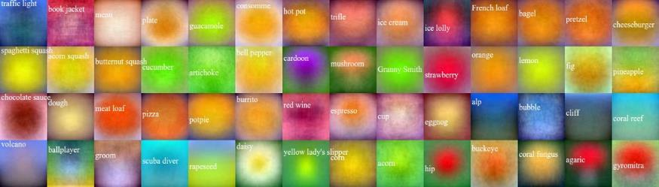
Breaking Linear Classifiers on ImageNet
Recall CIFAR-10 linear classifiers
ImageNet classifiers
http://karpathy.github.io/2015/03/30/breaking-convnets/
Computer Vision

Slide 53
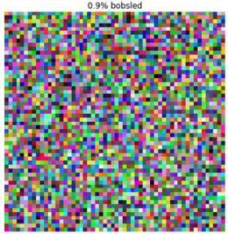
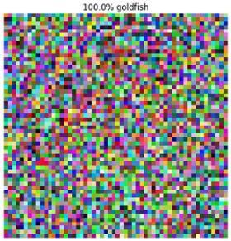
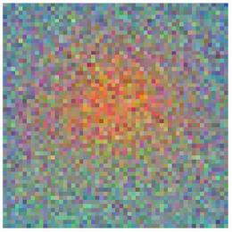
Mixing Weights
+
=
Goldfish classifier weights
100% Goldfish
Computer Vision

Slide 54
Practical Attacks
Fool real classifiers trained by remotely hosted API (MetaMind, Amazon, Google)
Fool malware detector networks
MALGAN
Display adversarial examples in the physical world and fool machine learning systems that perceive them through a camera
[Goodfellow, 2016]
Computer Vision

Slide 55
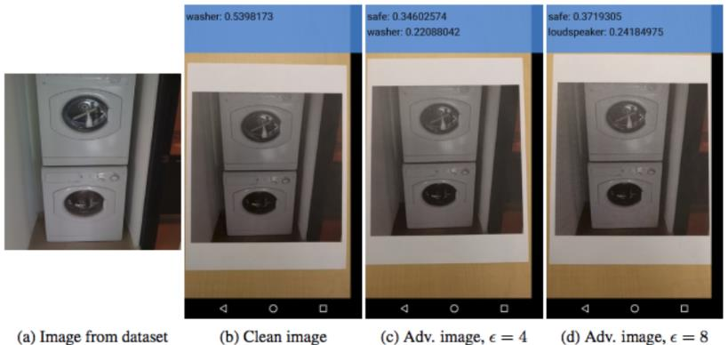
Adversarial Examples in the Physical World
[Kurakin et al, 2016]
Computer Vision

Slide 56

Question?
Computer Vision

Slide 57

Next Agenda
Generative Models
Computer Vision

Slide 58
References
Fei-Fei Li, Andrej K, Justin J - Stanford CS231n 2016 Course
Fei-Fei Li, Justin J, Serena Y - Stanford CS231n 2018 Course
Justin Johnson– EECS498 Lectures, University of Michigan
Grauman, K. and Leibe, B. 2011. Visual Object Recognition. Synthesis Lectures Artif. Intell. Mach. Learn. 5, 1 181
Computer Vision

